Slide 1


AI-Driven Hyper-Personalization
Harnessing AI to tailor recommendations based on unique user behaviors and preferences enhances engagement and improves user experience in digital contexts.

Slide 2

Introduction to Hyper-Personalization
Definition and Importance
Hyper-personalization uses AI to create tailored experiences.
Business Impact
Improved customer retention and increased sales.
AI Role
AI enhances data collection for better understanding.

Slide 3




Recommendation Systems Overview
Recommendation systems analyze user behavior, preferences, and item characteristics to suggest relevant content or products, enhancing user experience.
How They Work
Types of Systems
Challenges
Analyze user behavior and preferences.
Collaborative, content-based, and hybrid systems.
Address data sparsity and algorithm bias.

Slide 4




Enhancing Recommendations with AI
AI leverages advanced machine learning algorithms to analyze vast amounts of data, refining recommendations over time based on user interactions.
Machine Learning Approaches
Real-time Data Analysis
Feedback Loops
Adapts recommendations based on user behavior.
Continuous learning improves algorithms.
AI leverages advanced algorithms.

Slide 5
AI-Driven Recommendations
AI-driven recommendations refer to personalized suggestions made by algorithms that learn from user data to predict what a user might be interested in next.
The goal is to enhance user experience, increase engagement, and drive business outcomes.
How AI-Driven Recommendations Work
Data Collection: Gathering user data (e.g., browsing history, purchase patterns, ratings). Data Analysis: AI models analyze this data to find patterns and predict preferences.
Recommendation: Suggestions are made based on these insights.
Feedback Loop: User responses refine future recommendations.

Slide 6
Current Approach
Data Lake
Analytics
Personas
Capture further Insights
Clusters
Generic Offerings & service
Segments
Campaign Management

Slide 7









Transformation Journey
I wonder when that offer for a new car I want will come in …?
Individual Experience
Credit score
Networked Market
Social
Dealership offers
Intent to buy
Profile
Bank Smart Recommendation
Serve Consumer Model
Current Prosumer Model
New CONVERSUMER

Slide 8
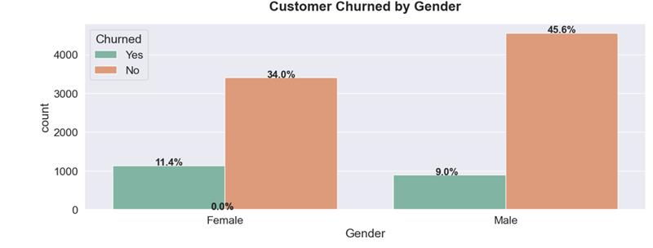
Project Insights

Slide 9
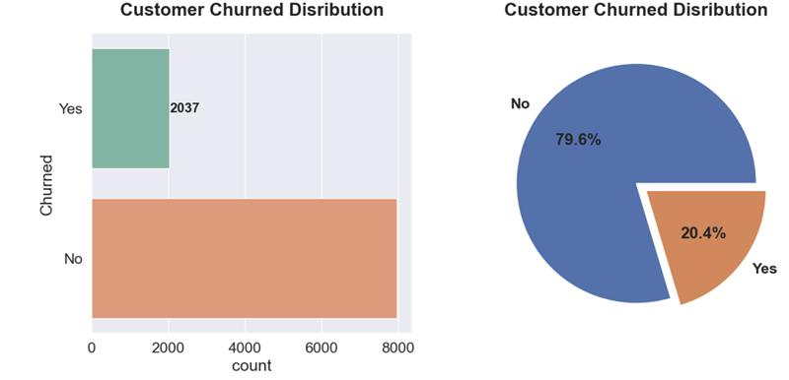
Project Insights

Slide 10
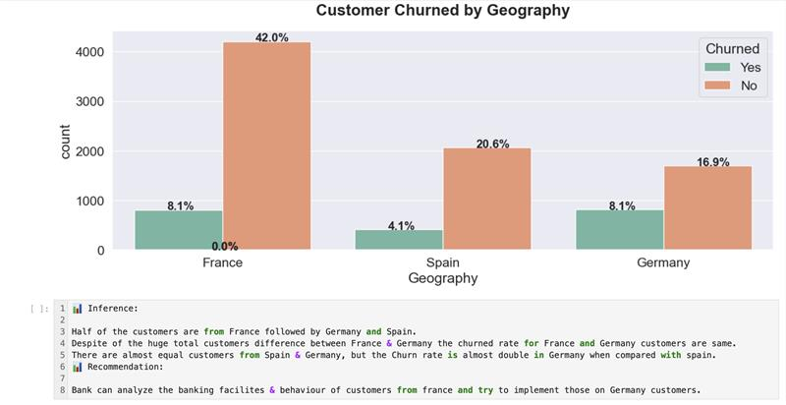
Project Insights

Slide 11
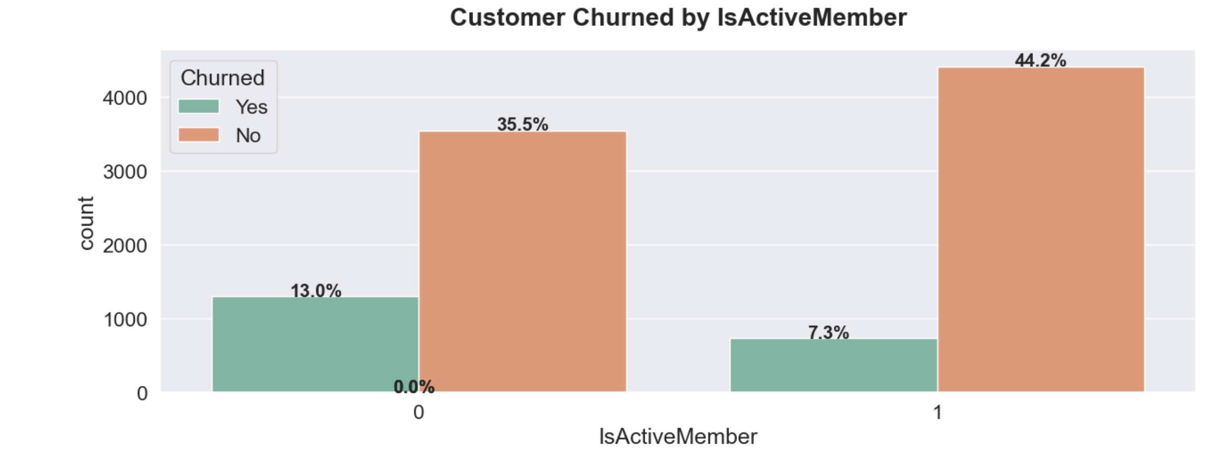
Project Insights

Slide 12
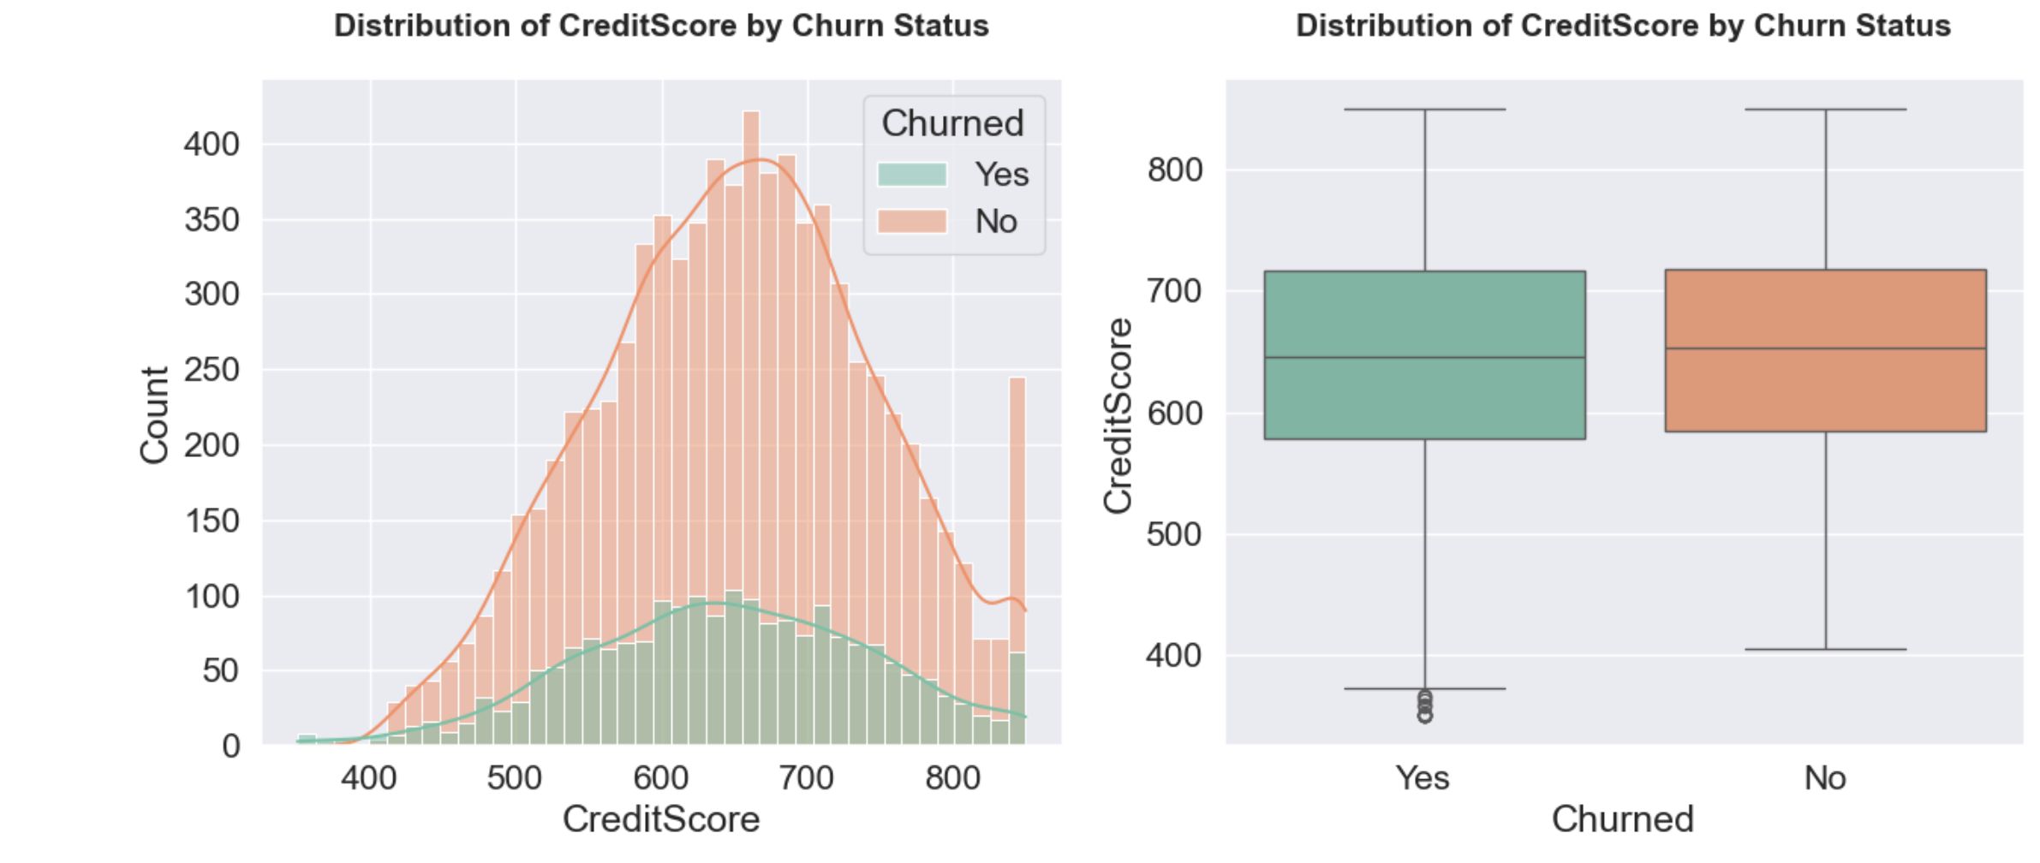
Project Insights

Slide 13
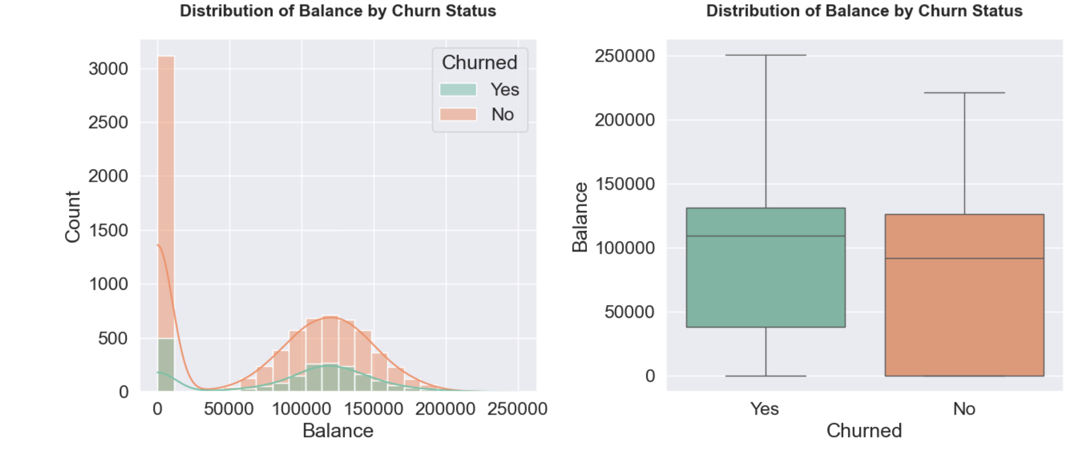
Project Insights

Slide 14
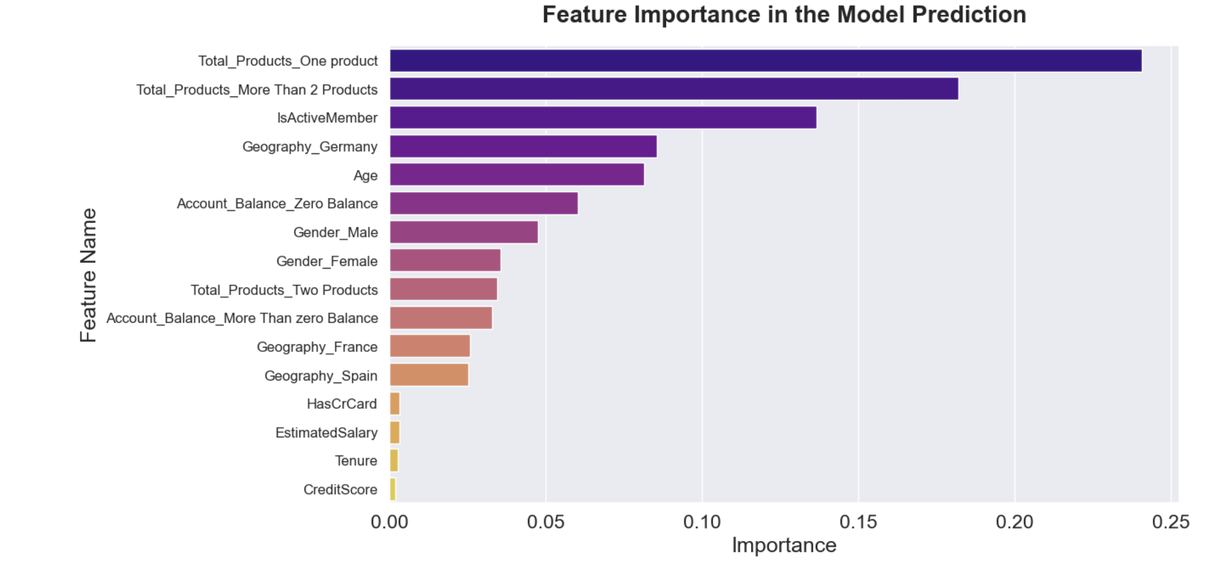
Project Insights

Slide 15
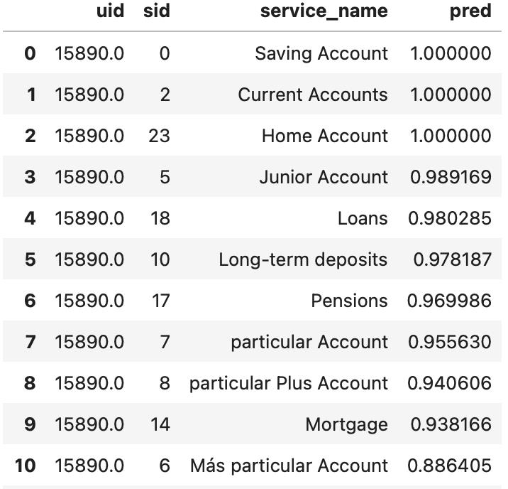
Recommendation Model Prediction

Slide 16
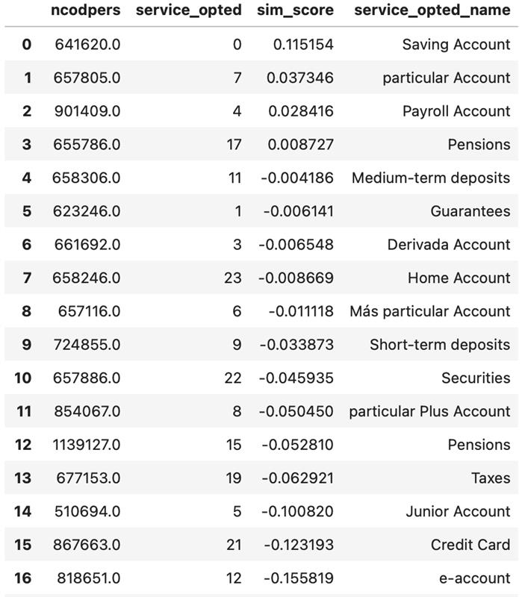
Recommendation Model Prediction

Slide 17

Download Insights and User Behavior
Understanding Downloads
Analyzing download data identifies user interests.
Segmentation of Users
Facilitates user segmentation for tailored recommendations.
Performance Metrics
Tracking metrics drives strategic improvements in personalization.

Slide 18


Case Studies of Success
1
E-commerce Platforms
2
Streaming Services
3
Mobile Apps
Companies like Amazon utilize hyper-personalization effectively to enhance user experience.
Platforms such as Netflix leverage AI-driven recommendations to keep users engaged.
Apps like Spotify offer personalized playlists based on listening history.

Slide 19




Future Trends in Hyper-Personalization
Advancements in AI
Privacy Considerations
Cross-Channel Strategies
Ongoing developments in AI and machine learning will further enhance the capabilities of hyper-personalization.
Balancing personalization with user privacy concerns will be crucial.
The integration of hyper-personalization across multiple touchpoints will enhance brand loyalty.

Slide 20


Conclusion and Takeaways
Benefits of Hyper-Personalization
Need for Continuous Innovation
Invest in AI Technologies
Investment in AI tools is essential to maximize hyper-personalization.
Companies must continuously innovate to meet evolving consumer expectations.
Enhances customer experiences, leading to greater satisfaction and retention.

